Slide 1
THz Ryegrass Hydration Measurement
14-May Report
Reporter: Jialu Xing
Supervisor: Dominik Vogt

Slide 2
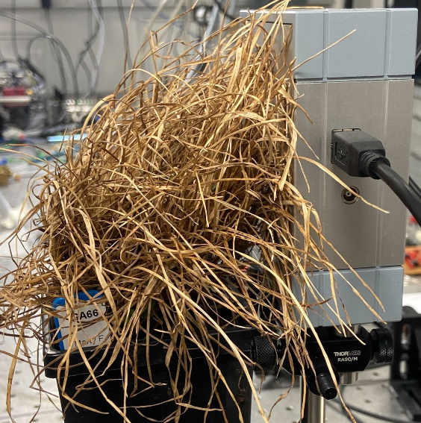
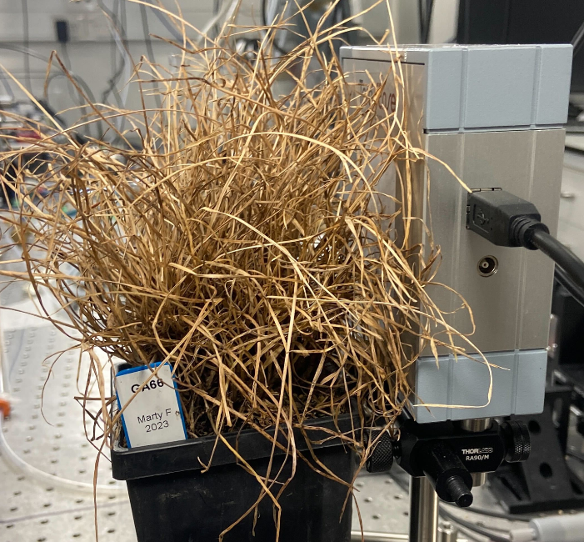
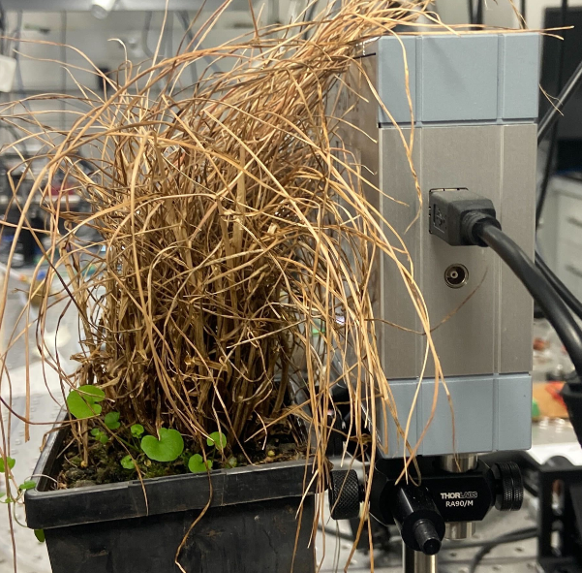
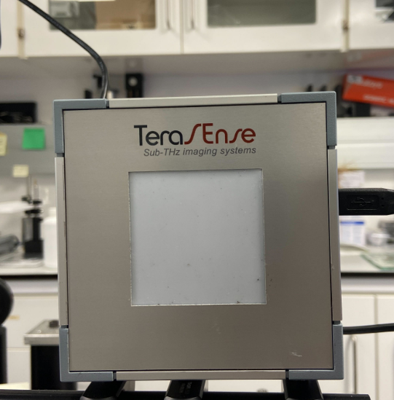
Recap: Empty pixel
Dry plants GA66-1:
Average saturated attenuation: 8.875 dB Average pixel value: 0.49133940625
Dry plants GA66-2:
Average saturated attenuation: 9.1125dB Average pixel value: 0.491919609375
Dry plants One50:
Average saturated attenuation: 6.45625 dB
Average pixel value: 0.493481125
Empty screen:
Average saturated attenuation: 10.49375 dB
Average pixel value: 0.49057878125
Two GA66 plants have similar data, so saturated attenuation may be related with species.

Slide 3
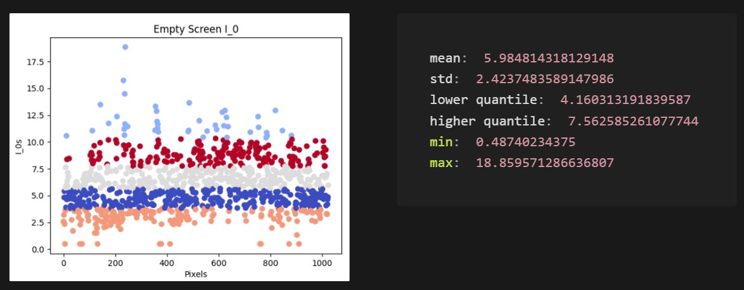
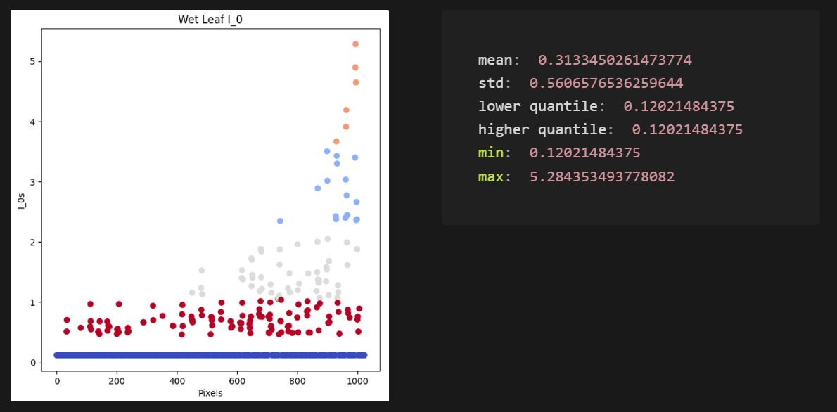
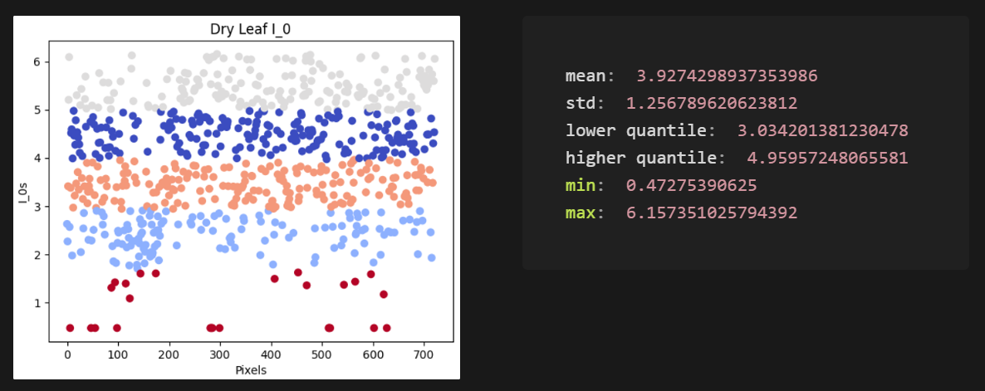
Recap: Empty pixel
I_0 = 10^(dB/10)*pixel_value
Set the I_0 threshold to 4.16
pixel_value < 4.16: pixel with leaf
pixel_value < 4.16: empty pixel

Slide 4
Recap: Long scan time
Scan process
Decrease attenuation
Check for saturated pixels and store the data
If still have un-saturated pixel
About 3-4 minutes to take one scan

Slide 5
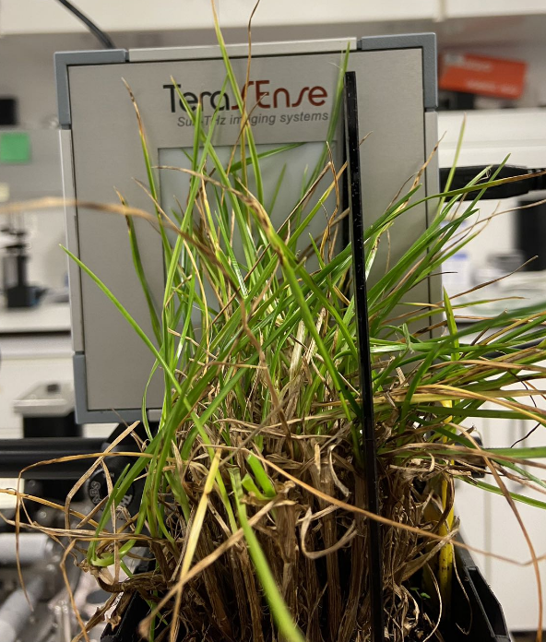
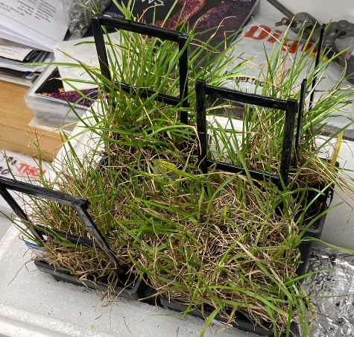
Plant Experiment
Repeat the leaf expr but on real plants
Plant experiment setup

Slide 6
Plant Experiment
Repeat the leaf expr but on real plants
Gravimetric data
THz data
Plant experiment setup

Slide 7
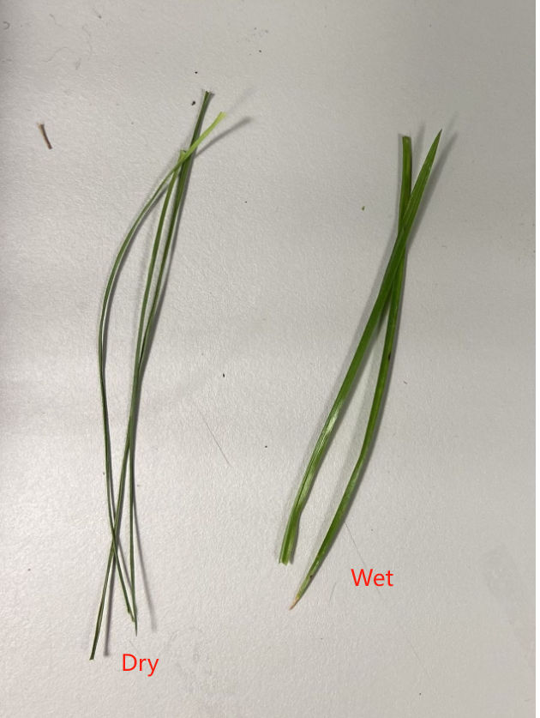
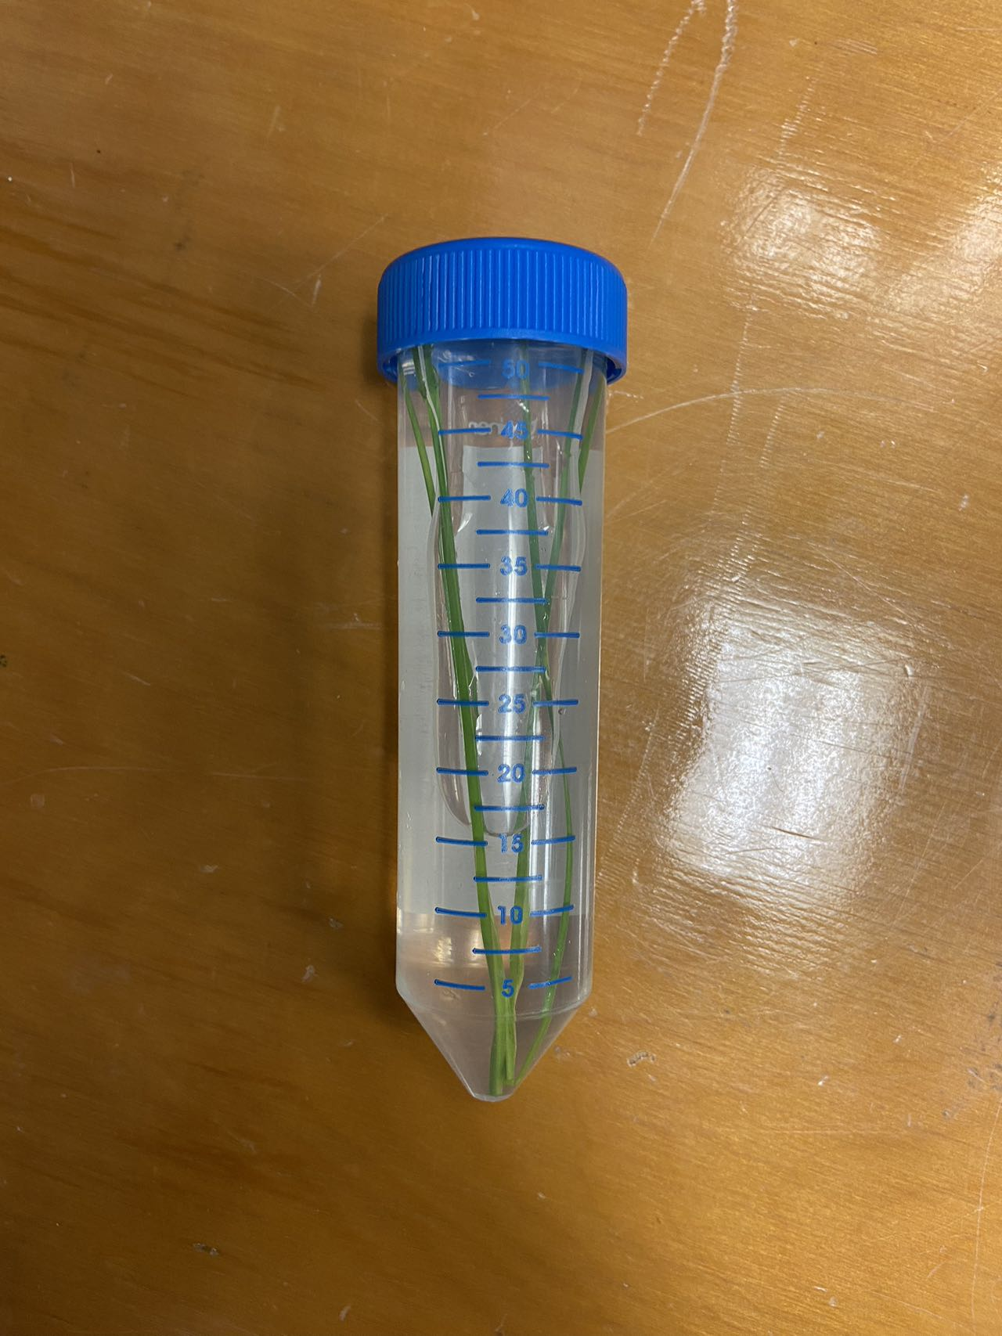
Plant Experiment
Repeat the leaf expr but on real plants
Plant experiment setup

Slide 8
Plant Experiment
Experiment process
Repeat until plants dry up
Leaf with around 95% RWC
Cut some leaf from the plant
Take THz data scan
Leave for one day to de-hydrate
Weight the leaf
W
Fully hydrate the leaf
Calculate the gravimetric RWC
Weight the fully hydrated leaf
TW
When dry up
Fully de-hydrate the leaf
Calculate the THz RWC
Weight the dry leaf
DW

Slide 9
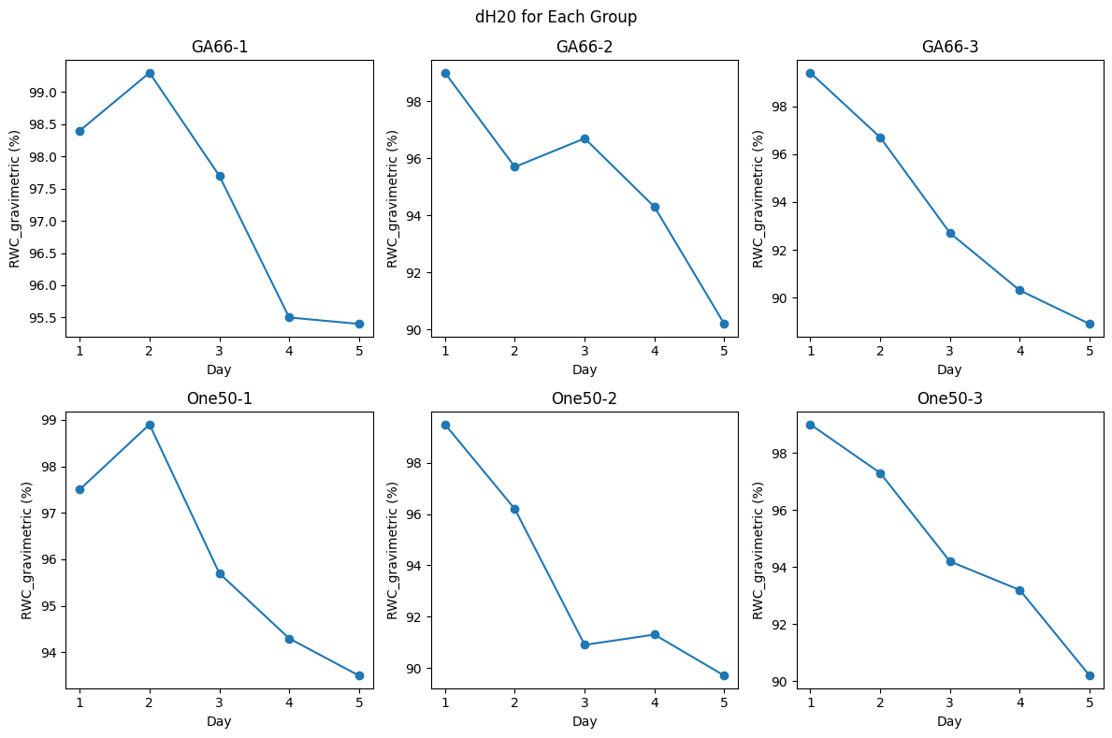
Plant Experiment
Result
The plants are not dry yet, so we can’t calculate the THz RWC now.
The gravimetric RWC result:
The gravimetric RWC shows that the plants is drying from 99% to 90%

Slide 10
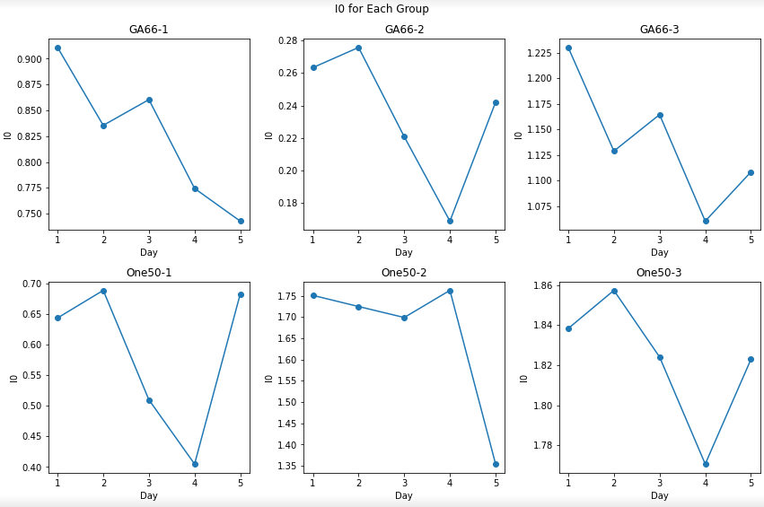
Plant Experiment
Result
I_0 = 10^(dB/10)*pixel_value
The I_0 results of Day1-Day6 are not promising
The I_0 results are expected to have an upward trend

Slide 11
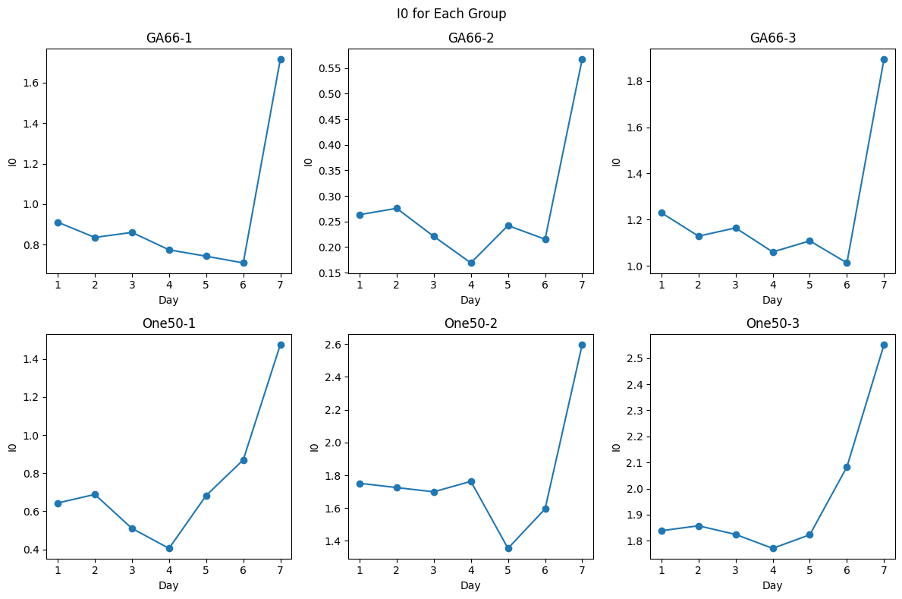
Plant Experiment
Result
We try to put the plant in the oven (100° for 5mins) to accelerate the drying process(Day 7)
The I_0 result shows a significant change
The former I_0 results (Day1-Day6) could be influenced by noise, as RWC only experienced slight changes.

Slide 12
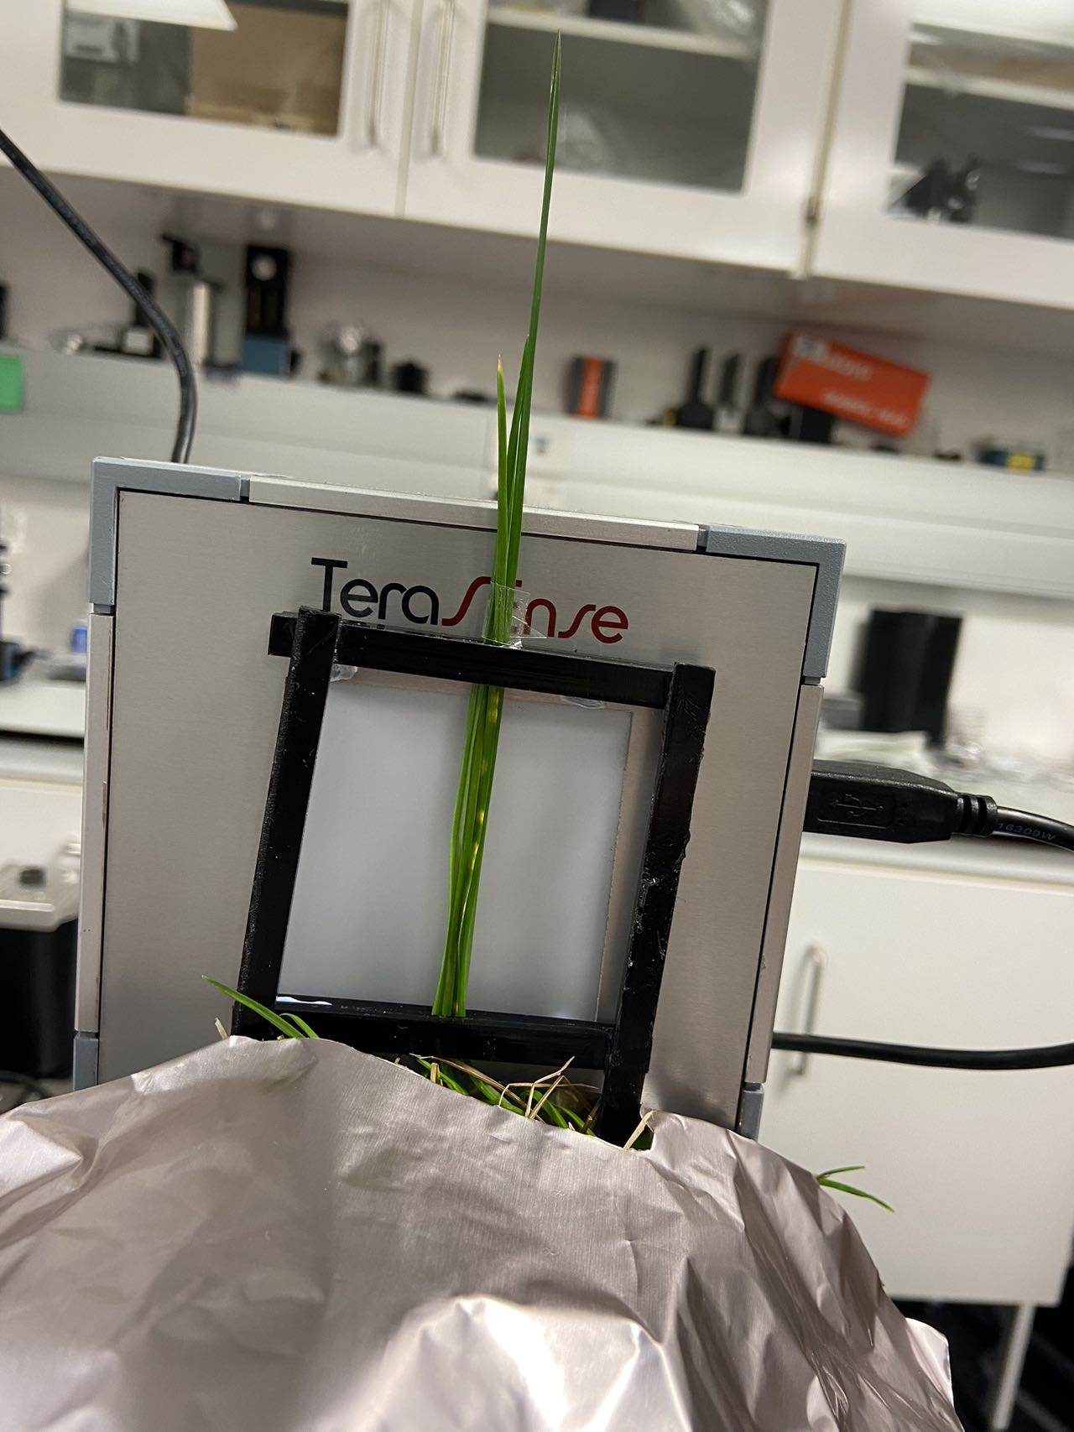
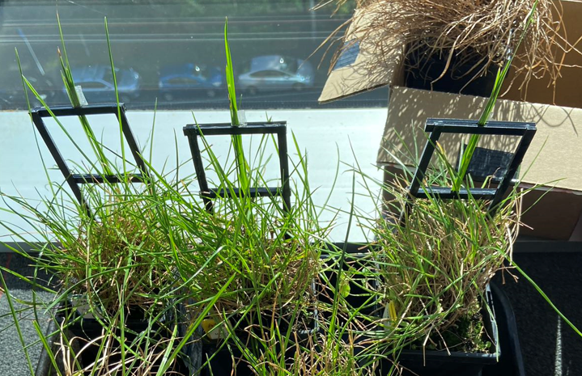
Other trails
Fixed leaves
Take THz scan for the same leaves every time
Cut other leaves to calculate the gravimetric data
The gravimetric and THz data don’t match on different leaves

Slide 13
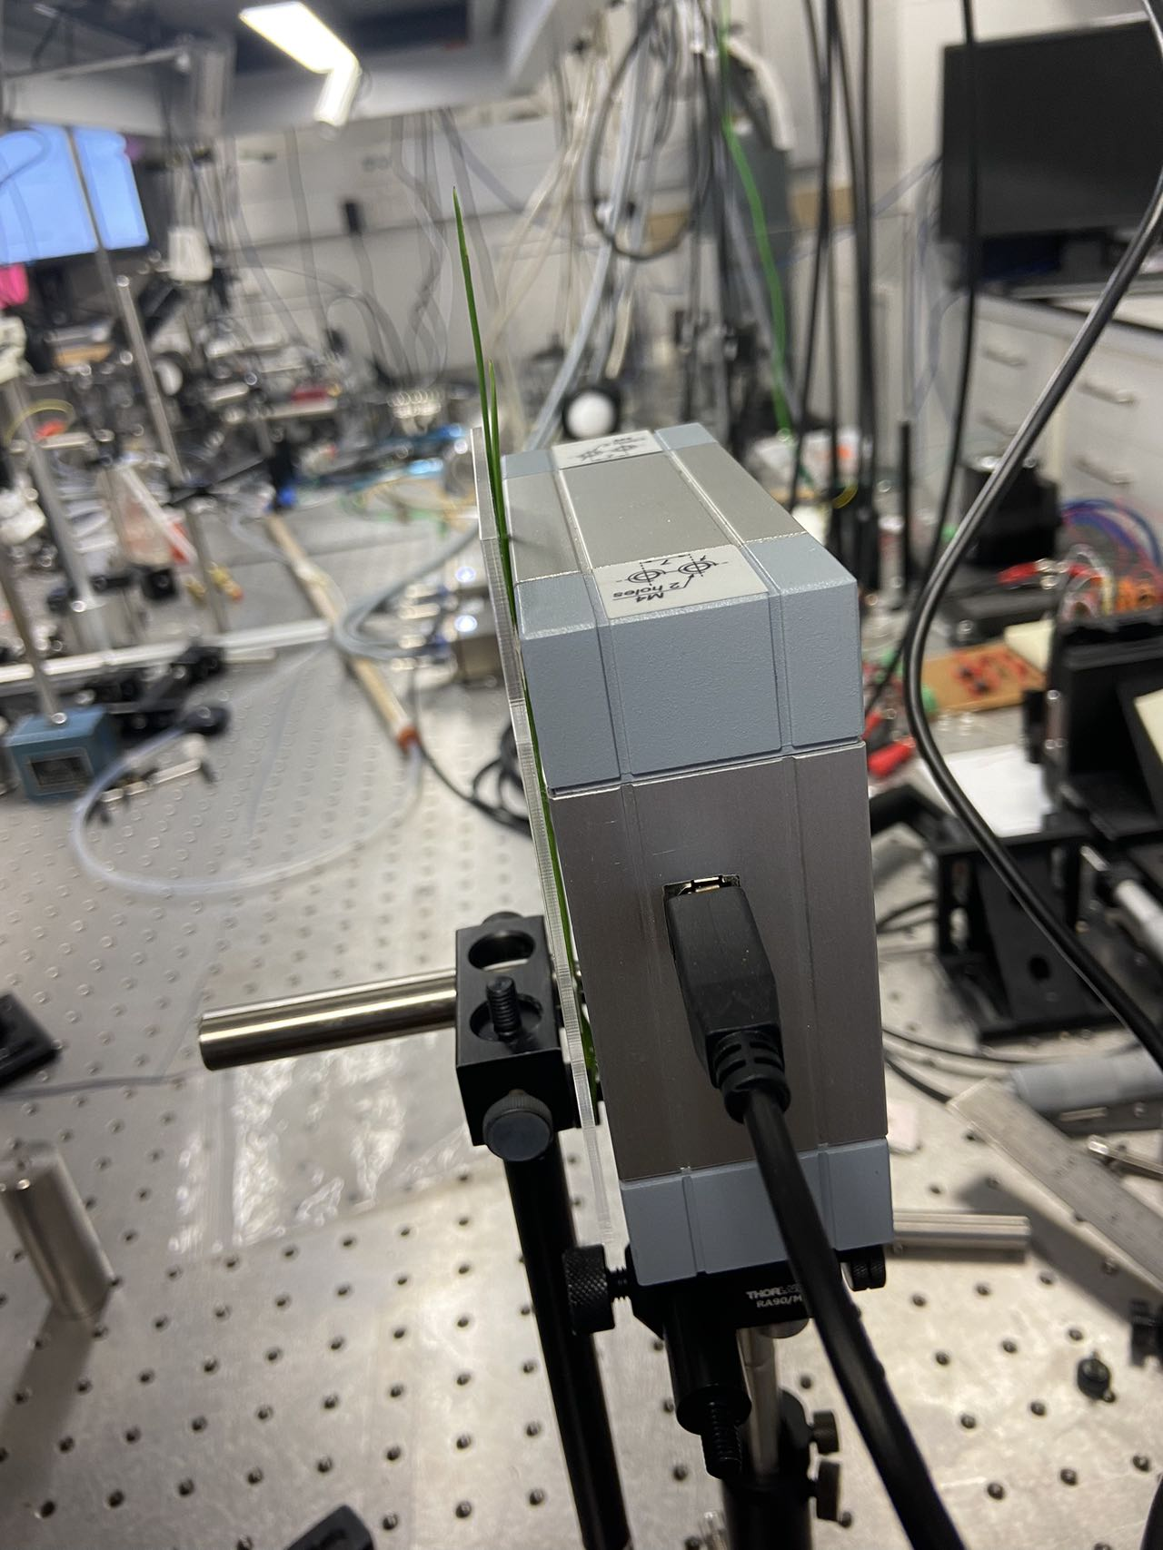
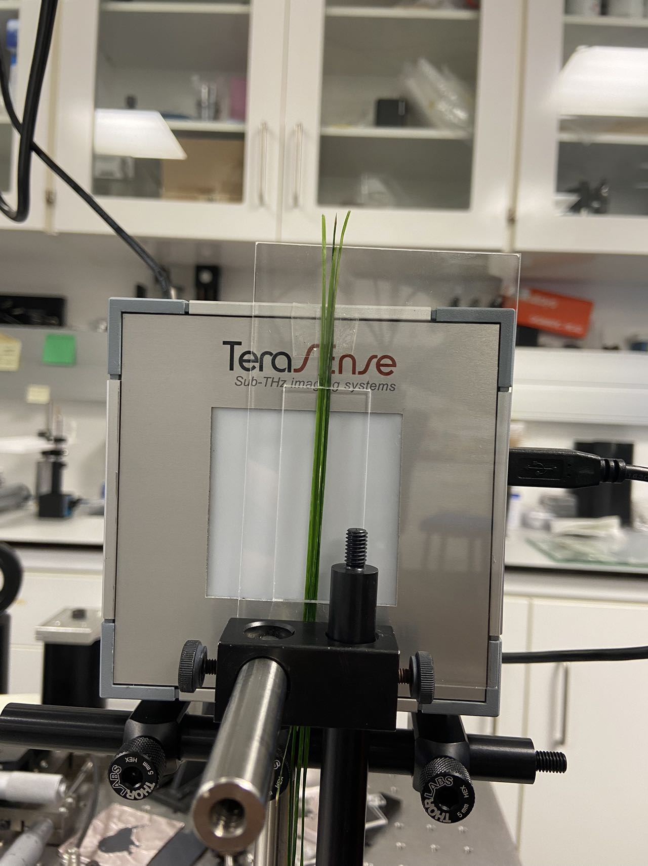
Other trails
Cut leaves
Every time cut some leaves and take THz scan and gravimetric data
Wet the leaves and take THz scan and gravimetric data
Dry the leaves and take THz scan and gravimetric data
Leaves starts to shift when dried

Slide 14
Problems
When the plant has dried to certain extend, it’s hard to measure the gravimetric RWC because we can’t get the turgid weight of the dried leaf
100° for 5mins in the oven maybe too long for the plant.

Slide 15
Outlook
Complete this round of THz measurements on the whole plants using the oven for drying to get an appropriate drying time and temperature, to get more data points
Complete another round of the THz measurements on the whole plants using the oven for drying

Slide 16
Thank you!

